Slide 1
FLOFAB Energy Savings
Via pump optimisation and VFD

Slide 2
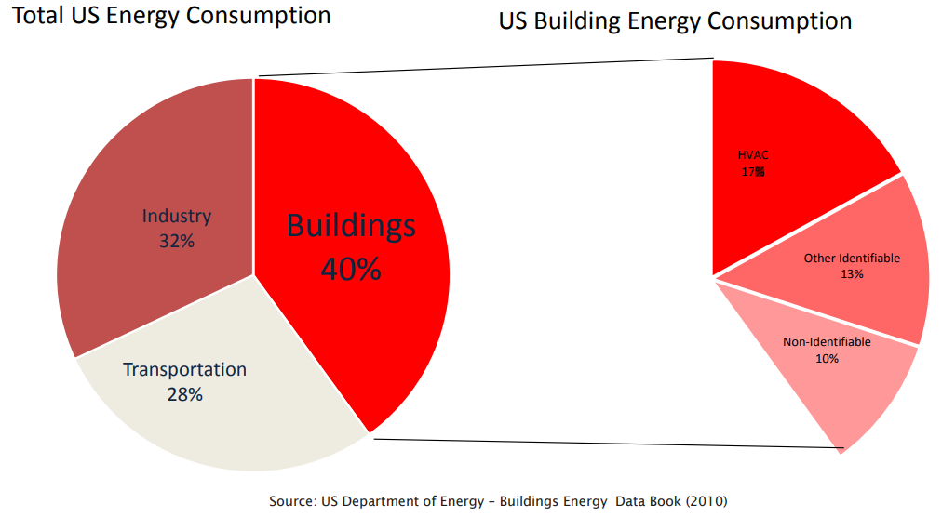
Use Energy Consumption

Slide 3
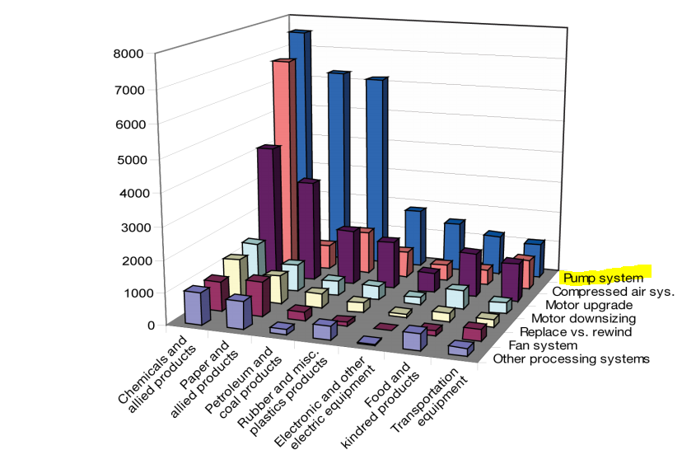
Pump Systems Have Greatest Energy-Saving

Slide 4
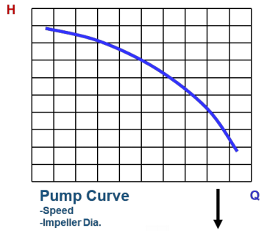
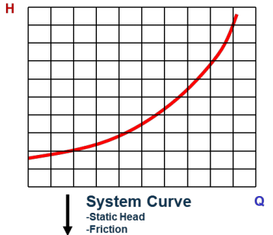
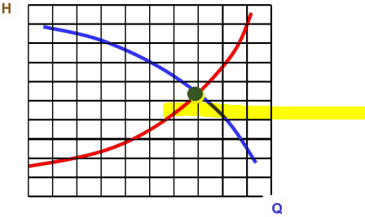
The System: What is a System Curve?
A system curve represents the sum of the static head and the friction loss due to flow of fluid through a system. The pumping system will operate where the pump and system curves intersect System curves help demonstrate pumping system behavior in a graphical manner If a system curve can be determined, it can help identify the effects of pump and/or system modifications

Slide 5
System Optimization and Improvement Opportunities
•Eliminate unnecessary uses • Improve piping configuration • Consider alternative pump configurations • Change pump speed •Using a pump when the fluid is not needed • Running two pumps when only one is needed • Excessive pump head or flow

Slide 6
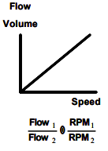
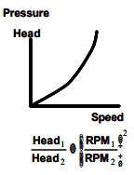
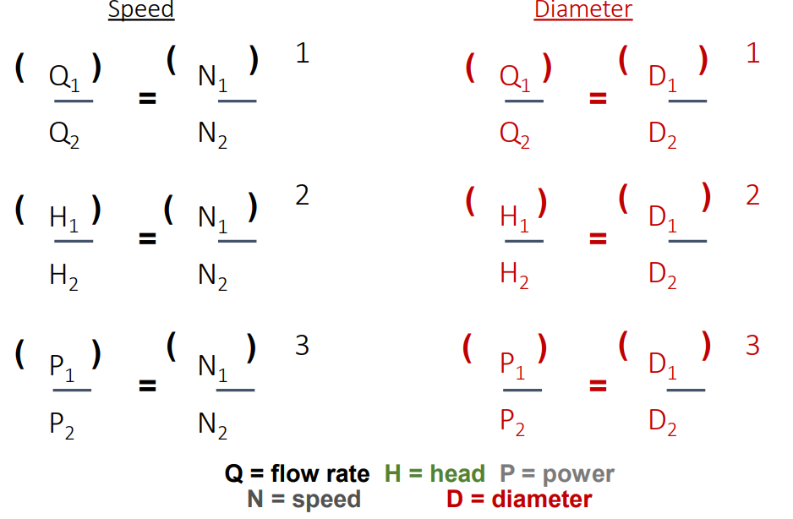
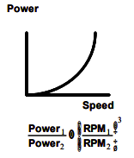
Pump Affinity Rules

Slide 7
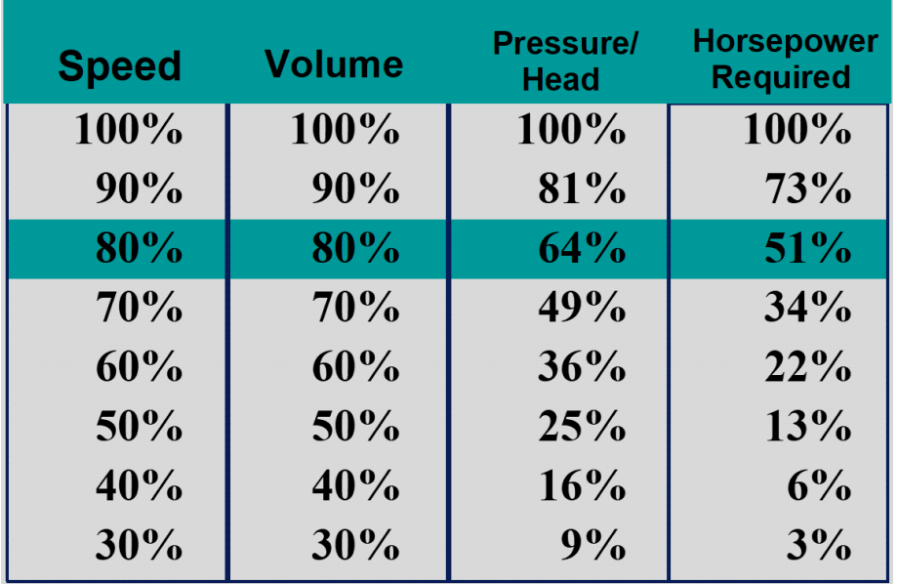
Pump Affinity Rules

Slide 8
Best Energy Efficiency using VFD
Because we know the affinity rules, we notice that key variable is speed. VFD (Variable Frequency Drive): Electronic unit that varies the fixed mains voltage & frequency to control the speed of standard a.c. electric motors

Slide 9
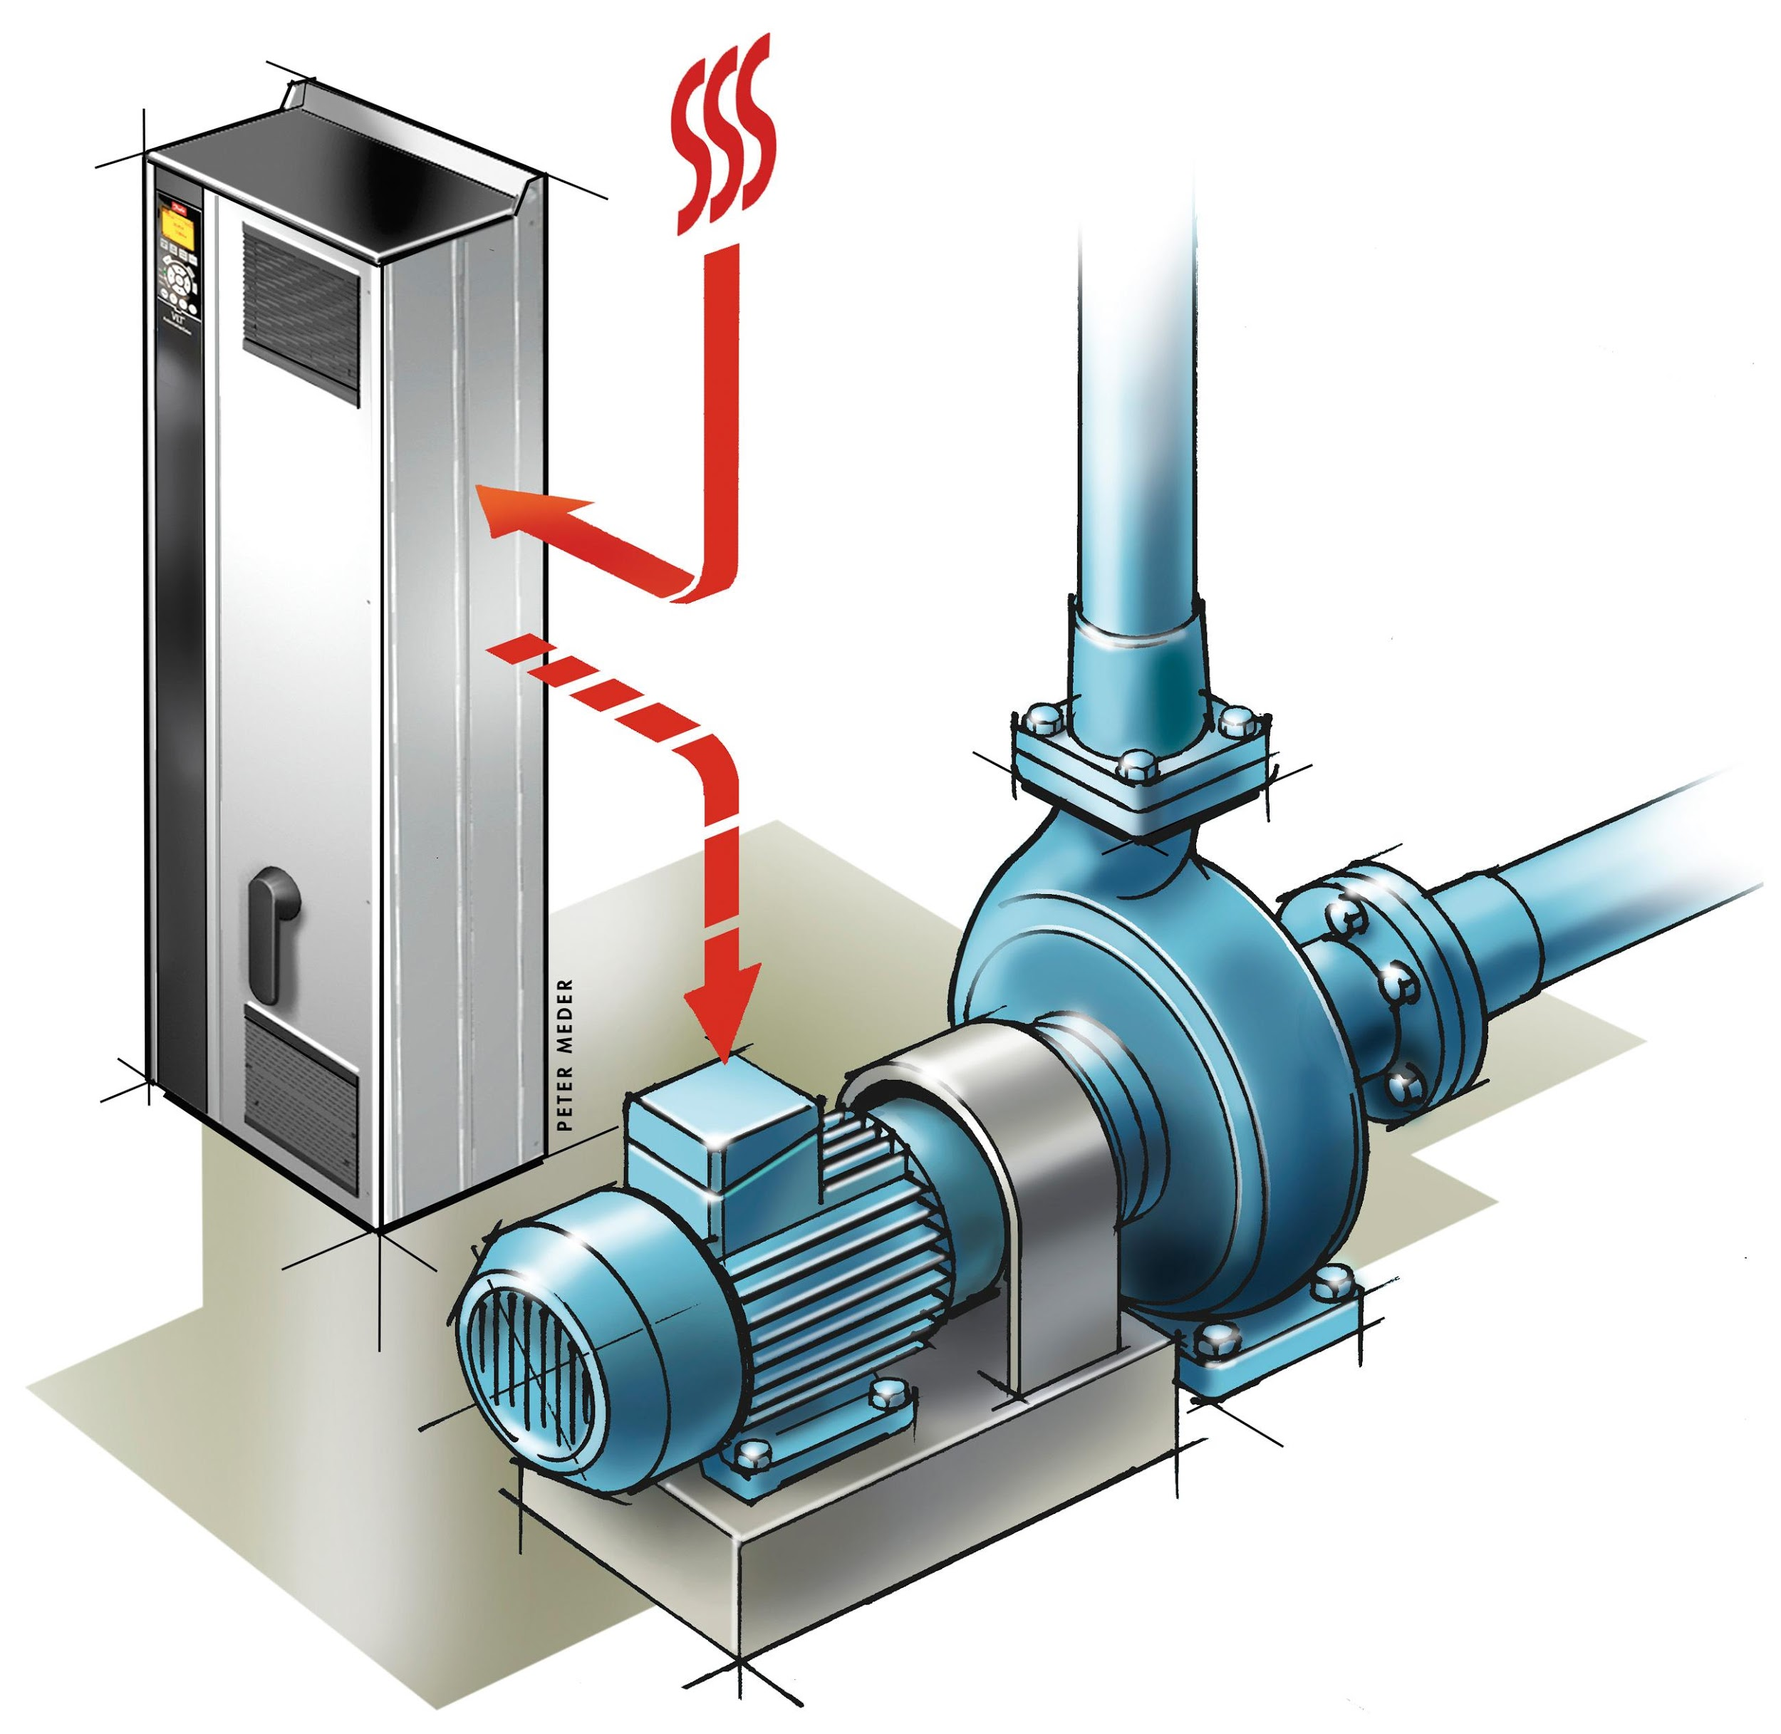
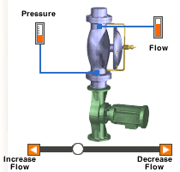
Throttling Valve compared to VFD

Slide 10
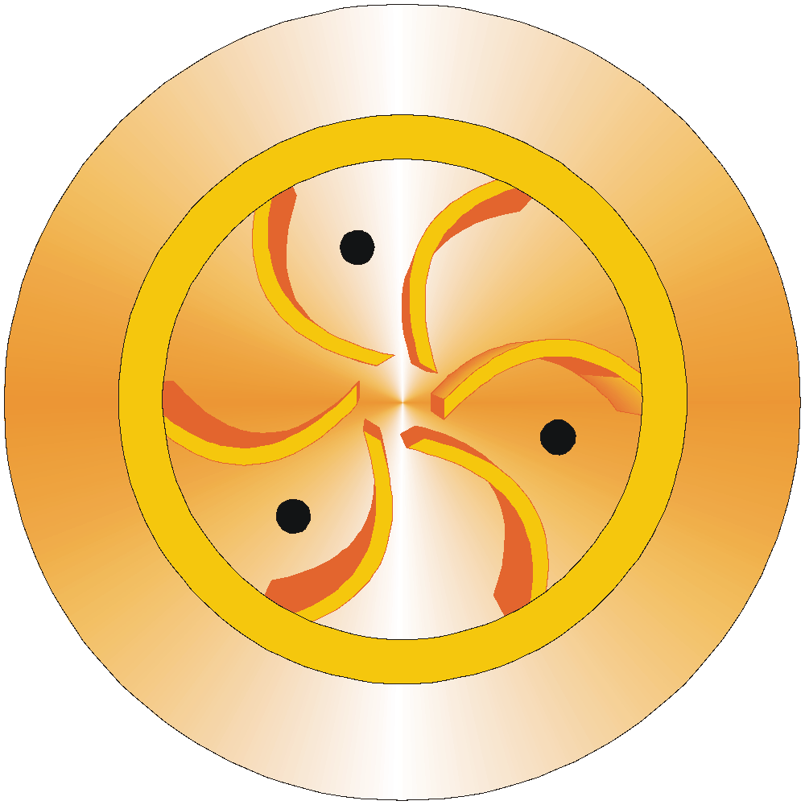
Flow Control – Impeller Trimming
Head
Full Diameter Impeller
Best Efficiency
Point
Energy
Consumed
A = Design Flow
B = Actual Flow
Flow
A
B

Slide 11
Flow Control – Impeller Trimming
Head
Energy
Consumed
Note: Trimming the impeller increases losses & irreversible!
Flow
A
B

Slide 12
Throttling valve – duty flow
Head
Energy
Consumed
Aim for operation at best efficiency point for lowest energy consumption
Flow

Slide 13
Throttling – reduced flow
Head
Discharge pressure increases and only a small reduction in energy.
Energy
Consumed
Flow

Slide 14
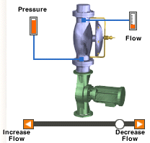
Throttling valve – low flow
Head
Some savings in energy but high temperature rise in pump housing & reduction in bearing & seal life)
Energy
Consumed
Flow

Slide 15
Flow Control - Throttling
Head
Cavitation
Can Occur
Energy
Consumed
Flow

Slide 16
Pump Reliability and BEP

Slide 17
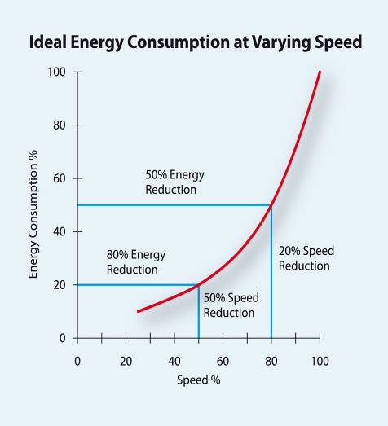
Typical energy savings with VFD on centrifugal pumps
Flow is proportional to speed
Power varies to the cube of the speed
change
20% reduction in speed = 50% reduction in energy
50% reduction in speed = 80% reduction in energy

Slide 18
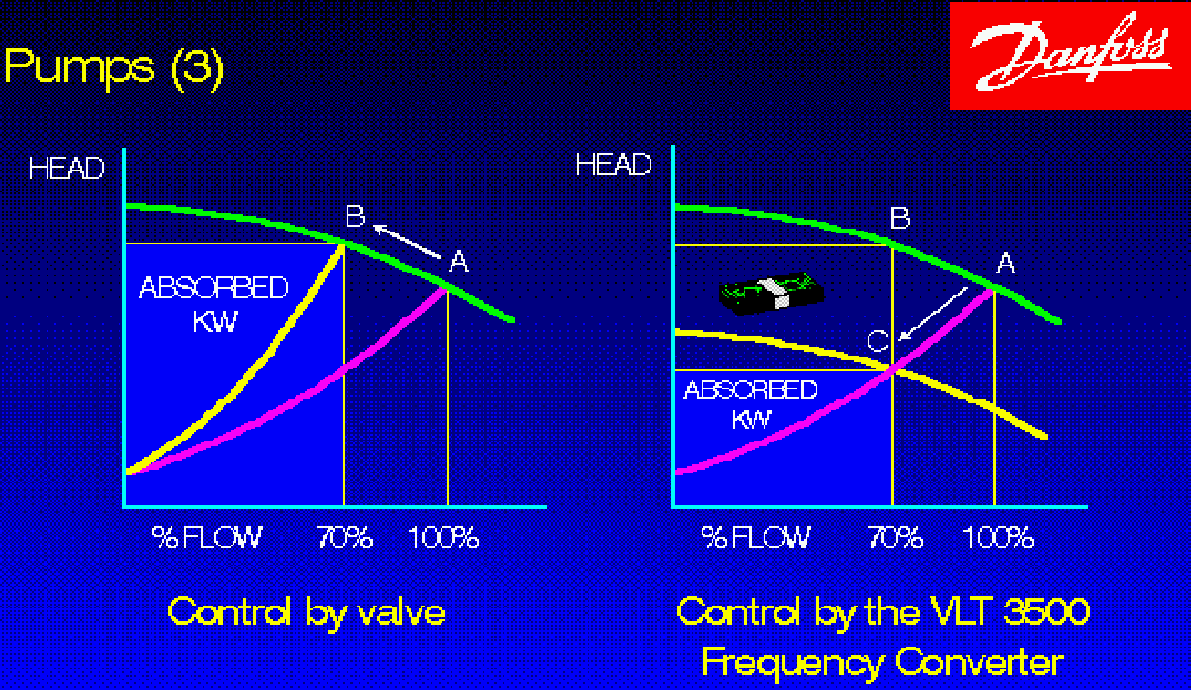
Throttling valve compared to VFD
Control with valves
Control with VSD
VFD gives ~35% energy savings compared to throttling valve (On typical variable flow applications)

Slide 19
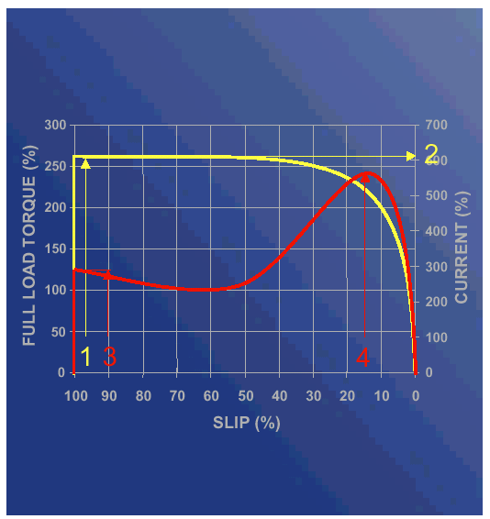
Motor starting current & torque (As a % rated motor torque on typical centrifugal water pump)
Direct on line start
VFD start
Starting current
~500-600%
~30-40%
Starting torque
~ 250-350%
~30-40%
VFD start
Significantly lower starting current &
torque
Controlled acceleration & deceleration
(adjustable ramp up & down times)
Very smooth starting & stopping

Slide 20
Speed control of pumps in parallel can save energy

Slide 21
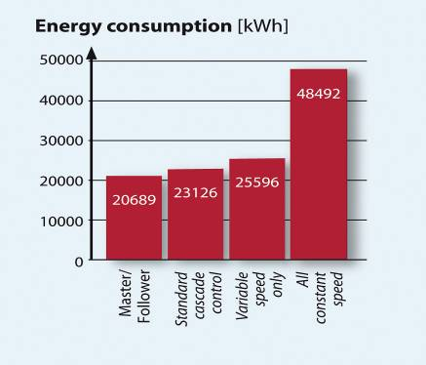
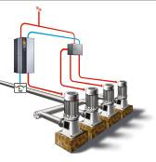
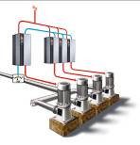
Energy consumption of single & multiple pump systems @ same flow
Single VFD controlled pump
100%
Standard cascade control with 1 x VFD pump & multiple fixed speed pumps
48%
53%
43%
Master – follower with 1 x VFD per pump
Note: kWh figures are approximate relative %, based on sample test
Master follower = best energy efficiency

Slide 22
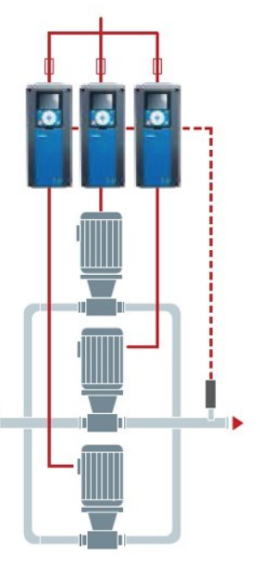
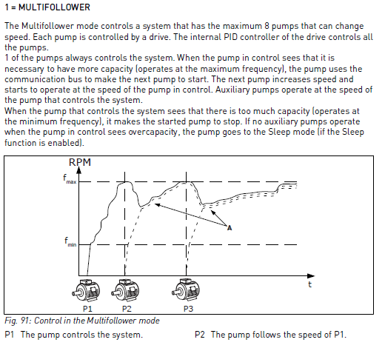

Slide 23
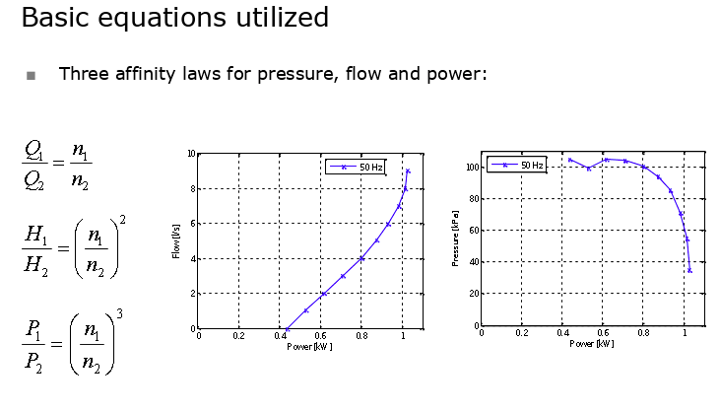
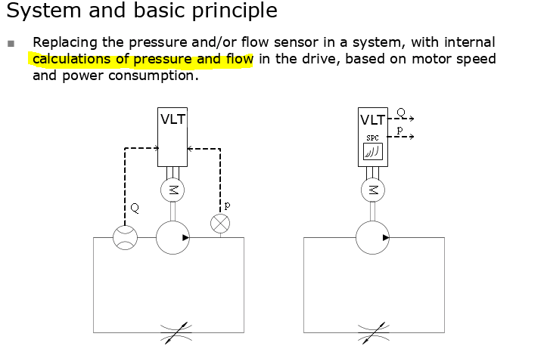
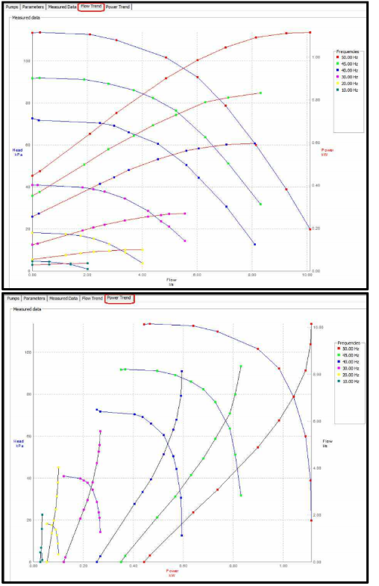
Concept of Sensorless

Slide 24
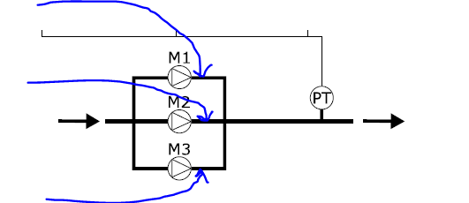
Avoid Sensorless in Boosters
Because this relation between power/pressure/flow exist, we can estimate head pressure and flow from a single motor power data.
That is not valid for the total system pressure and flow. Additionnal controller would be used to sum data from drive 1 and 2, system becomes complex and hard to debug.
It will look to combine data from M1 – M2 – M3.
As for sensor read perfectly system pressure

Slide 25
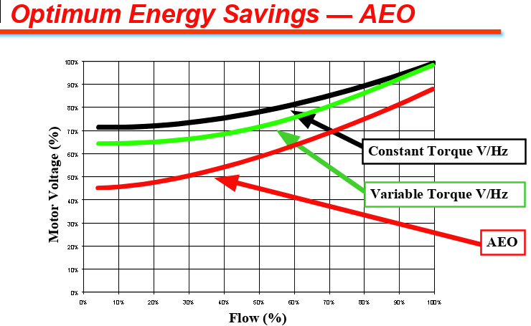
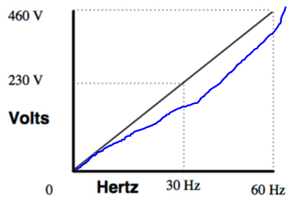
AEO can not be used with sensorless
Automatically reduces motor voltage at light load
Reduces motor current draw Reduces motor power consumption Reason it does not work with AEO: Since Power and speed is used to estimate Pressure or flow, Power can not vary, AEO optimise power.

Slide 26
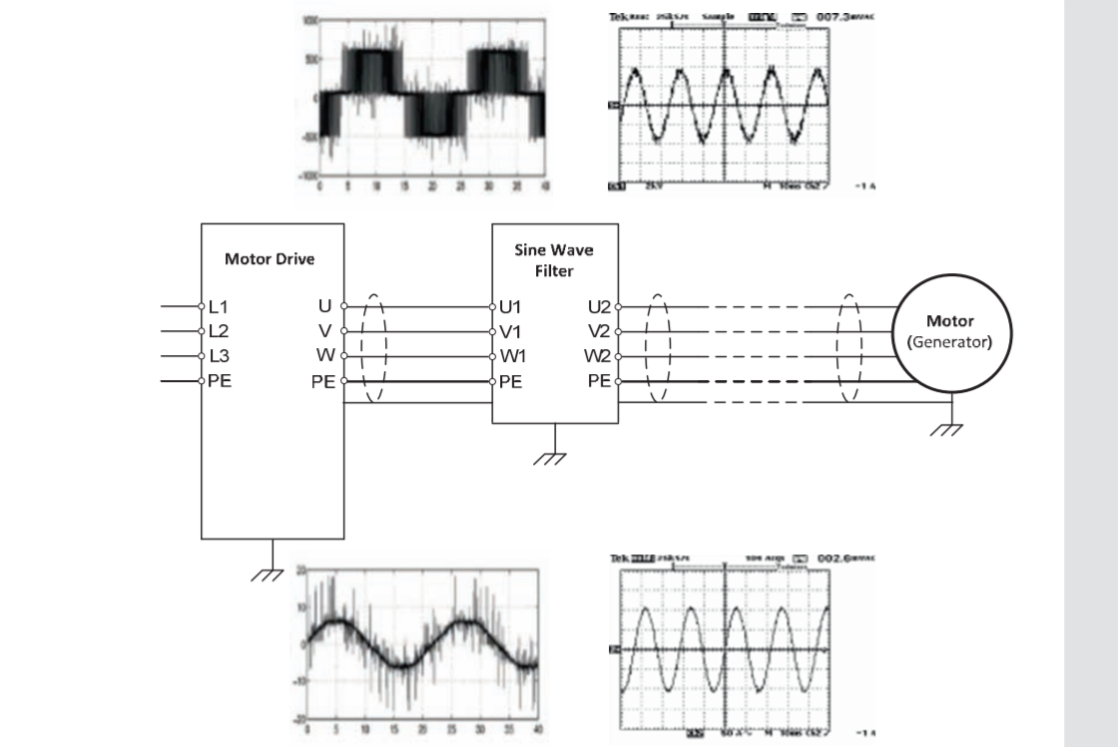
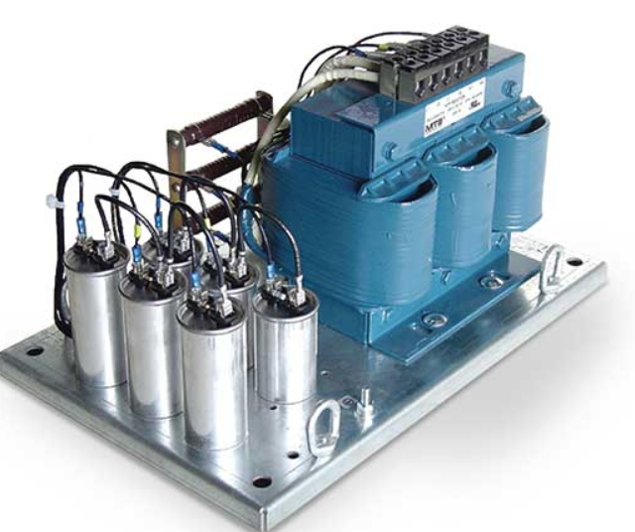
Protecting Older motors with SinWave filters

Slide 27
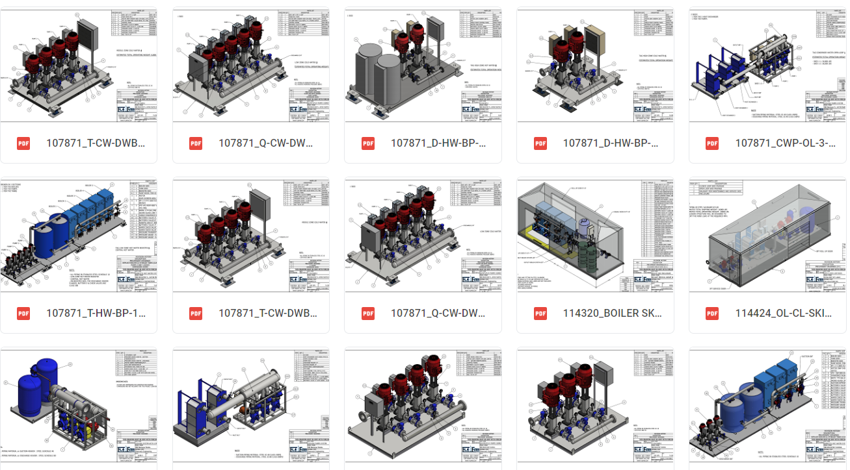
Application Examples

Slide 28
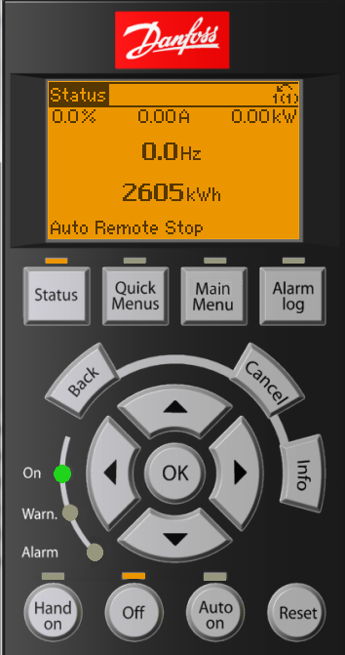
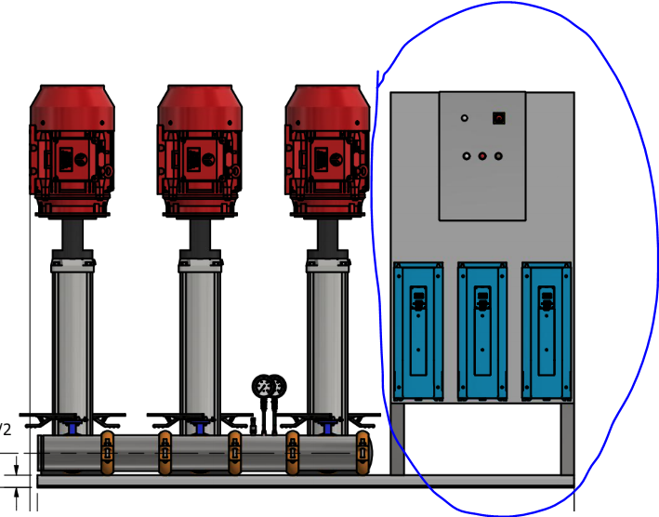
Possible retrofit
Look at existing applications
Install turn key panels
Protect exsiting motors or
update with new.
Update features with KW counters
Etc..

